Slide 1


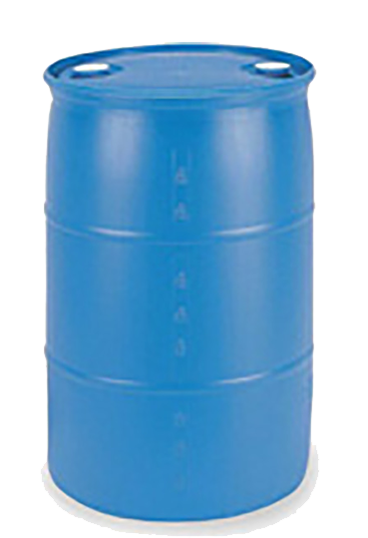
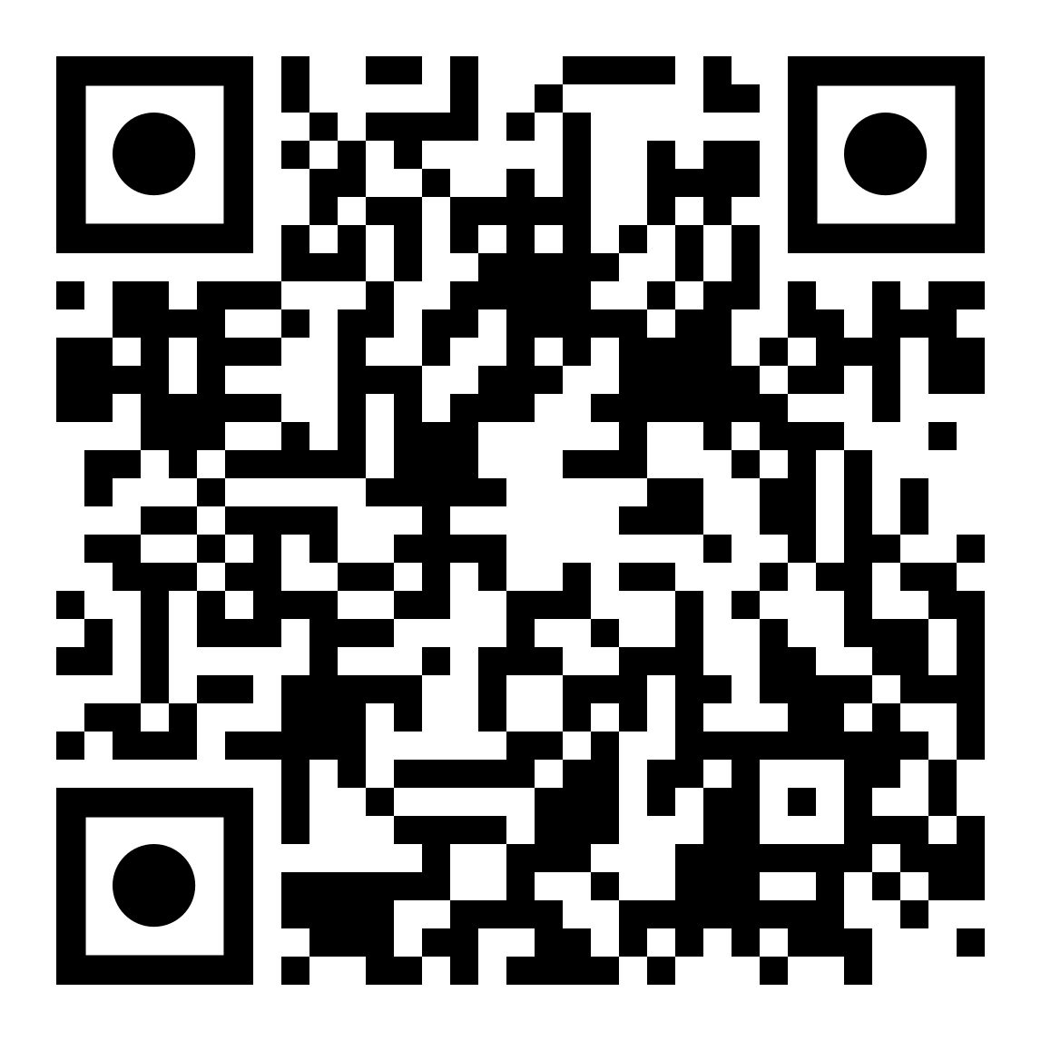
 | Renton Fish & Game Club Bay 1 Stage: Shoot Up Them Magazine Clips Course Designer: Kris Erickson
"What's the efficacy of banning these magazine clips? I will tell you... these are ammunition, they're bullets. So the people who have those now, they're going to shoot them, so if you ban them in the future, the number of these high capacity magazines is going to decrease dramatically over time because the bullets will have been shot and there won't be any more available." – Rep. Diana DeGette (D-CO). SCENARIO: As a goodwill gesture to Rep. DeGette, let’s shoot up a bunch of our magazine clips so she doesn’t have to worry about them anymore.
START POSITION: Squarely facing T1, toes on marks. Handgun loaded and holstered, wrists below belt. PCC loaded, stock on belt, muzzle pointed downrange. |  | STRINGS: 1 SCORING: Unlimited SCORED HITS: Best 2 ROUND COUNT: 18 TARGETS: 6 IDPA, 4 PP START-STOP: Audible - Last shot CONCEALMENT: Required Muzzle Safe Points: 180 degree rule SO NOTES:
STAGE PROCEDURE: At the start signal, engage T1 with at least 4 rounds. From P1, engage T2-T4 with at least 2 rounds each. While moving to P2, you are surprised by T5, T6, and PP1. From P2, engage PP2-PP4. NOTES:
PP1
PP2
PP3
PP4
T6
T5
T4
T2
P2
T1
T3
START
P1
https://www.youtube.com/watch?v=rT7TOL_V08M

